Slide 1


Global Climate Change
Week 5 – The Evidence Base for Climate Change
Dr Thomas Bannan
Thomas.Bannan@Manchester.ac.uk

Slide 2
Discussion
Argue against: “The Earth’s climate is always changing and this is nothing to do with humans.”
How might measurements support this argument?

Slide 3

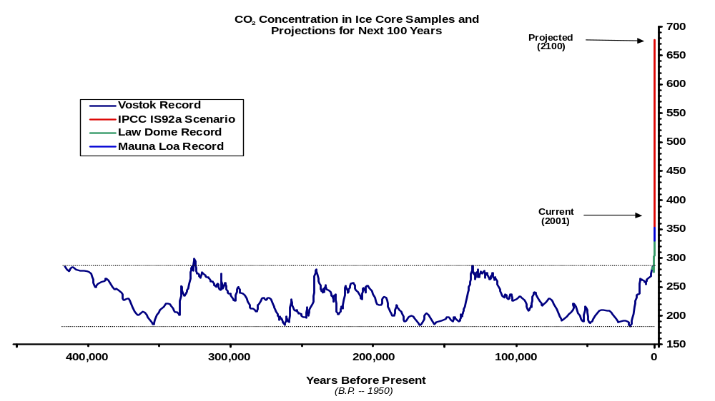

Brief Answer
Argue against: “The Earth’s climate is always changing and this is nothing to do with humans.”
We understand natural sources of variability, and they cannot explain observed temperature trends.
Climate models can only reproduce observed temperature trends if anthropogenic forcings are included.
Rate of changes are unprecedented in the past record and correlate closely with anthropogenic GHG emissions.
The fundamental physics behind the greenhouse effect is well established and understood.
And the next few slides of the lecture!

Slide 4
Global Climate Change
Week 5 – Questions and Answers
Dr Thomas Bannan
Thomas.Bannan@Manchester.ac.uk

Slide 5
Q1.
Critically compare instrumental records, ice cores, and proxy data.
Which type of evidence do you find most convincing, and why?
How does agreement between independent datasets increase confidence?
Are there any datasets you would trust less? On what basis?

Slide 6
Q1. Answer
Critically compare instrumental records, ice cores, and proxy data.
Which type of evidence do you find most convincing, and why?
How does agreement between independent datasets increase confidence?
Are there any datasets you would trust less? On what basis?
It really depends on what question you are trying to ask, and at what spatial and temporal scale you are trying to answer it.
Instrumental records are the most convincing when we are interested in recent climate change because they provide high-accuracy, high-resolution measurements over the last approx. 100 years, allowing us to directly observe rapid increases in temperature and greenhouse gases. However, they tell us very little about how unusual the present climate is in a longer-term context.
Ice cores are less useful for understanding local or regional change, for example they will not tell us much about detailed climate variability in South America (as an example) but they are extremely powerful for examining global-scale climate behaviour over hundreds of thousands of years, showing how temperature and CO₂ vary through heating and cooling cycles and how exceptional concentrations are now.
Proxy records extend this perspective even further back, to millions of years, but at the cost of lower accuracy and coarser temporal resolution, meaning they are best suited to identifying long-term trends rather than short-term change.
No single dataset is “best” in isolation; confidence increases because instrumental data, ice cores, and multiple independent proxies all point to the same broad conclusions despite their different limitations and uncertainties.

Slide 7
Q2.
Where does uncertainty in climate data come from?
Which aspects of climate change are well understood, and which are not?
How should scientists communicate uncertainty without weakening the message?

Slide 8
Q2. Answer
Where does uncertainty in climate data come from?
Which aspects of climate change are well understood, and which are not?
How should scientists communicate uncertainty without weakening the message?
Uncertainty in climate data comes from how measurements are made and how far back in time we are looking. Instrumental records are the most reliable but still include uncertainties from calibration, changing methods, and uneven coverage, particularly over oceans and in the Southern Hemisphere. When we rely on ice cores and proxies, uncertainty increases further because signals are smoothed over time and because proxies respond to multiple environmental factors rather than temperature or CO₂ alone.
Some aspects of climate change are therefore much better understood than others. Global mean temperature change is one of the most robust signals we have, because it is supported by multiple independent datasets, including surface stations and satellites, all showing consistent warming trends. Similarly, the rise in atmospheric CO₂ is well constrained and clearly linked to fossil fuel use. In contrast, regional and local climate changes are harder to pin down, largely because natural variability is larger at smaller spatial scales and observational coverage is more uneven. This is why we are generally more confident about global trends than about exactly how precipitation or extreme events will change in a specific location.
The key uncertainties in climate forcings are shown in the figure on the next slide. Uncertainty also varies strongly depending on the climate driver being considered, which is well illustrated by the IPPC radiative forcing figure that you should now be familiar with. Greenhouse gases such as CO₂, CH₄ and N₂O sit at the high end of scientific understanding, with well-constrained, positive radiative forcing estimates and relatively small uncertainty. In contrast, aerosols show much lower levels of understanding, with wide uncertainty bars and even disagreement over the sign of their net effect, reflecting difficulties in measuring their distribution, lifetime, and interactions with clouds. This contrast highlights an important point from the lecture: while uncertainties remain in some components of the climate system, particularly aerosols and land-use effects, the dominant warming influence from greenhouse gases is both large and robust, and uncertainty in other forcings does not undermine confidence in the overall conclusion of human-driven warming.

Slide 9
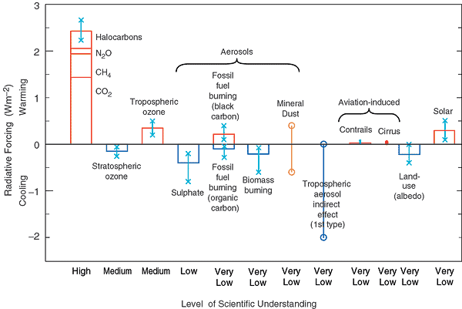
Q2. Answer
Where does uncertainty in climate data come from?
Which aspects of climate change are well understood, and which are not?
How should scientists communicate uncertainty without weakening the message?
A key challenge for scientists is communicating this uncertainty clearly without undermining the strength of the evidence. The lecture emphasises that uncertainty does not mean a lack of understanding; rather, it reflects the limits of measurements and the complexity of the climate system. By being explicit about where confidence is high, such as global warming driven by greenhouse gases, and where it is lower, such as local-scale impacts or cloud feedbacks, we can present an honest picture of where we at at.
Agreement between independent lines of evidence is crucial here, as it allows strong conclusions to be drawn even when individual datasets contain uncertainty. This is why the work of the IPCC is so important. More on this in a couple of weeks.

Slide 10
Q3.
Why are global trends easier to detect than local changes?
How does internal variability complicate short-term or regional analysis?
What are the implications for adaptation planning at local scales? (we will think more about this in week 8)

Slide 11
Q3. Answer
Why are global trends easier to detect than local changes?
How does internal variability complicate short-term or regional analysis?
What are the implications for adaptation planning at local scales? (we will think more about this in week 8)
Global trends are generally easier to detect than local changes because averaging over large spatial scales reduces the influence of short-term natural variability and measurement inaccuracies. When temperatures are averaged globally, random fluctuations such as weather events or regional circulation patterns tend to cancel out, revealing a clear long-term signal. This is why global mean temperature shows a strong, consistent warming trend across multiple datasets, whereas individual regions may experience periods of cooling or no clear trend despite ongoing global warming. The lecture emphasises that uncertainty is lower at global scales and higher at regional and local scales, partly because observational coverage is more complete globally than for specific locations.
Internal variability further complicates the detection of local or short-term changes. Processes such as El Niño–Southern Oscillation can dominate climate signals over years to decades, masking or exaggerating the underlying warming trend in particular regions. At local scales, this variability can be larger than the long-term climate signal itself, making attribution much harder. This explains why we can be very confident about global warming, but less certain about exactly how temperature or precipitation will change in a specific place over the next few decades.
The implication for adaptation planning is that local decisions often have to be made under greater uncertainty. While global projections provide a strong framework showing continued warming, regional and local planners must account for a wider range of possible outcomes and rely more on risk-based approaches. This mismatch between high confidence at the global scale and lower confidence locally is a reflection of how variability and uncertainty increase as we move to smaller spatial scales.

Slide 12
Q4.
How do scientists separate human influences from natural variability?
Why are climate models essential for attribution?
What would the climate record look like if warming were purely natural over the last 100 years?

Slide 13
Q4. Answer
How do scientists separate human influences from natural variability?
Why are climate models essential for attribution?
What would the climate record look like if warming were purely natural over the last 100 years?
We separate human influences from natural variability by combining observations with physical understanding and climate models. Measurements show that temperatures and greenhouse gases have risen together, but on their own they do not explain why this is happening. By accounting for known natural drivers such as solar variability, volcanic eruptions, and internal variability, we can test whether these processes are sufficient to explain the observed warming. The lecture shows that none of these natural drivers produce a sustained warming trend, whereas anthropogenic greenhouse gases do.
Climate models are very important for attribution because they allow different forcings to be included or excluded in a controlled way. When models are run with natural forcings only, they fail to reproduce the observed temperature rise. When human forcings are added, the models closely match the warming seen in instrumental records. This provides strong evidence that recent climate change cannot be explained without human influence.
If warming over the last 100 years were purely natural, we would expect to see stronger solar trends, more persistent volcanic effects, or symmetric warming throughout the atmosphere, none of which match observations, reinforcing the conclusion that recent warming is primarily anthropogenic.

Slide 14
Q5.
If CO₂ is well mixed in the atmosphere, why do we measure it at remote sites like Mauna Loa or the South Pole?

Slide 15
Q5. Answer
If CO₂ is well mixed in the atmosphere, why do we measure it at remote sites like Mauna Loa or the South Pole?
Although CO₂ is well mixed in the atmosphere on large spatial scales, it is not perfectly uniform at local scales or over short time periods. In urban or industrial areas, concentrations can fluctuate significantly due to nearby fossil fuel combustion, traffic, vegetation uptake, and boundary layer effects. If we measured only in such locations, the long-term global trend would be obscured by short-term local variability.
Remote sites such as Mauna Loa and the South Pole are deliberately chosen to minimise these local influences. They are far from major population centres and industrial sources, and in the case of Mauna Loa, the high elevation means measurements are often taken above the local boundary layer, sampling well-mixed background air. The South Pole is even more isolated, making it an excellent location for monitoring air that reflects large-scale atmospheric mixing.
Because CO₂ has a long atmospheric lifetime, it becomes distributed relatively evenly around the globe. Remote baseline stations therefore provide a reliable measure of the global background concentration, allowing us to detect long-term trends clearly and consistently.
These sites also serve as reference points for calibrating instruments and validating satellite observations, strengthening confidence that the observed rise in CO₂ is a global signal rather than just a local process.

Slide 16
Q6.
Why do we need multiple climate proxies rather than relying on just one “best” proxy?

Slide 17
Q6. Answer
Why do we need multiple climate proxies rather than relying on just one “best” proxy?
We need multiple climate proxies because no single proxy provides a complete, perfectly reliable record of past climate.
Each proxy responds to climate in a different way, operates over different timescales, and contains its own uncertainties and biases. For example, tree rings can provide high-resolution records over the past few centuries, but they are influenced not only by temperature but also by moisture, nutrients, CO₂ concentration etc. Ice cores preserve direct samples of past atmospheric gases and isotopic temperature signals, but their temporal resolution decreases with depth and they are geographically limited. Marine sediments extend much further back in time, yet they often integrate signals over centuries or longer, smoothing short-term variability.
Because each proxy records climate indirectly and is influenced by multiple environmental factors, relying on just one could lead to misleading conclusions. Using multiple, independent proxies allows us to validate results and identify consistent patterns. When different types of evidence (e.g. biological, chemical and physical) provide the same conclusion, confidence increases substantially.
Agreement between independent proxies reduces the likelihood that observed trends are artefacts of a particular method or location.

Slide 18
Q7.
If solar variability were responsible for modern warming, what would the vertical temperature profile look like?

Slide 19
Q7. Answer
If solar variability were responsible for modern warming, what would the vertical temperature profile look like?
If solar variability were responsible for modern warming, we would expect to see warming throughout the atmosphere, both in the troposphere and in the stratosphere.
When solar output increases, more energy enters the Earth system across all wavelengths. Increased ultraviolet radiation is absorbed by ozone in the stratosphere, which directly warms that layer. At the same time, additional incoming solar radiation warms the surface and lower atmosphere. The result would be a broadly consistent warming extending upward through the atmosphere.
However, observations show a different pattern since the mid-20th century: the troposphere has warmed while the stratosphere has cooled. This vertical structure is a fingerprint of the greenhouse gas effect. Increasing CO₂ traps more outgoing longwave radiation in the lower atmosphere, warming the surface and troposphere.
So if solar variability were the dominant driver, we would see warming at all levels of the atmosphere. The observed pattern of tropospheric warming combined with stratospheric cooling strongly indicates that greenhouse gases, rather than solar changes, are responsible for recent warming.

Slide 20
Q8.
Why does uncertainty increase further back in time and at smaller spatial scales?

Slide 21
Q8. Answer
Why does uncertainty increase further back in time and at smaller spatial scales?
Uncertainty increases further back in time primarily because we move from direct measurements to indirect evidence. Over the last approx. 100 years we have instrumental records, which provide high-accuracy, high-resolution observations of temperature and greenhouse gases. As we go further back, we rely increasingly on things such as tree rings, ice cores, and sediments. These proxies record climate indirectly and are influenced by multiple environmental factors, not just temperature or CO₂.
In addition, temporal resolution decreases with age: annual layers near the top of an ice core may become multi-decadal or even millennial averages at depth due to diffusion and compaction. Dating uncertainties also grow, making it harder to align different records precisely. All of this increases uncertainty the further back we go.
Uncertainty also increases at smaller spatial scales because natural variability becomes more important relative to the long-term climate signal. Global averages smooth out regional fluctuations, as warm and cool anomalies in different areas tend to cancel out. At local or regional scales, however, internal variability, such as atmospheric circulation changes, ocean oscillations like ENSO, or short-term weather extremes, can dominate over the underlying warming trend, especially over short time periods. Observational coverage is also less complete in some regions, particularly over oceans, in the tropics, and in parts of the Southern Hemisphere, which further increases uncertainty at smaller scales.
Global-scale, recent climate change is the clearest signal because it benefits from dense measurements and statistical averaging. As we move backward in time or look into specific locations, the data become sparser, more indirect, and more influenced by variability, and uncertainty therefore grows.

